Slide 1


Stock Analysis and Modeling: Insights and Simulations
October 3, 2024

Slide 2

Company Overview (Nvidia)
Nvidia is a tech company that mainly produces GPUs. Its products are used in gaming, artificial intelligence, and data centers, helping to make computing faster and smarter. In recent years, machine learning and computing platforms have been widely used in artificial intelligence and high-performance computing.
Major business lines the firm has Gaming, Data Center, Professional Visualization, Automotive and AI & Machine Learning. Nvidia's Data Center business is its main profit driver due to the rapid growth of AI, deep learning, and high-performance computing

Slide 3
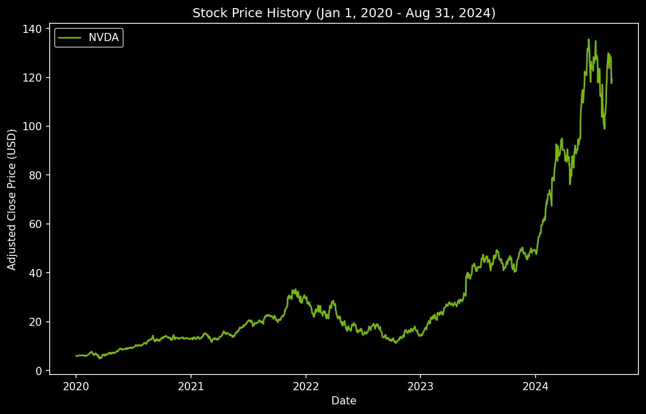
Profit and Stock Overview
Major business lines & profit engine (in 2024):
Data Center: $15.01 billion (55.6%)
Gaming: $8.52 billion (31.6%)
Professional Visualization: $1.47 billion (5.4%)
Automotive: $0.903 billion (3.3%)
OEM and Others: $1.06 billion (4.1%)

Slide 4
Stock Performance Comparison

Slide 5
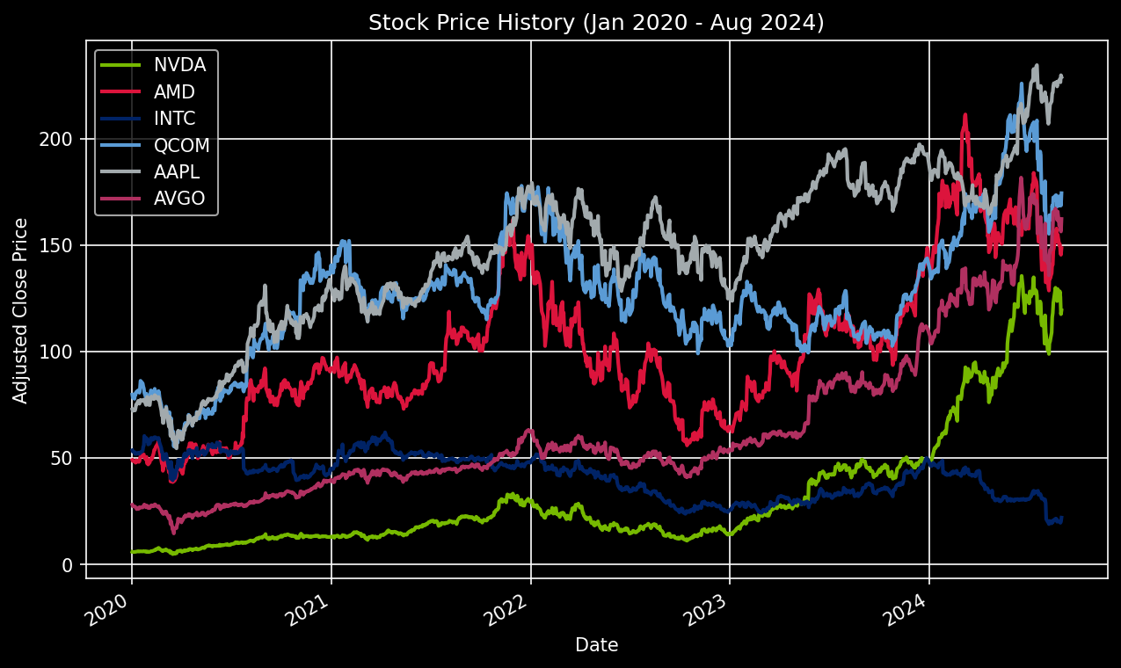
Stock Price History(Jan 2020 - Aug 2024)
Comparative Analysis of Leading Tech Stock
Comparative Analysis of Leading Tech Stocks (2020-2024)
Comparative Analysis of Leading Tech Stocks (2020-2024)

Slide 6
Stock Price Distribution Analysis (KDE)
Key Statistical Parameters
 | NVDA | AMD | INTE | QCOM | AAPL | AVGO
Mean | 31.73 | 100.65 | 41.4 | 126.97 | 146.76 | 63.06
Variance | 878.66 | 1238.74 | 97.47 | 935.47 | 1399.18 | 1312.74
Skewness | 1.88 | 0.67 | -0.17 | 0.31 | -0.34 | 1.34
Kurtosis | 5.77 | 2.93 | 1.97 | 3.42 | 2.89 | 3.69

Slide 7
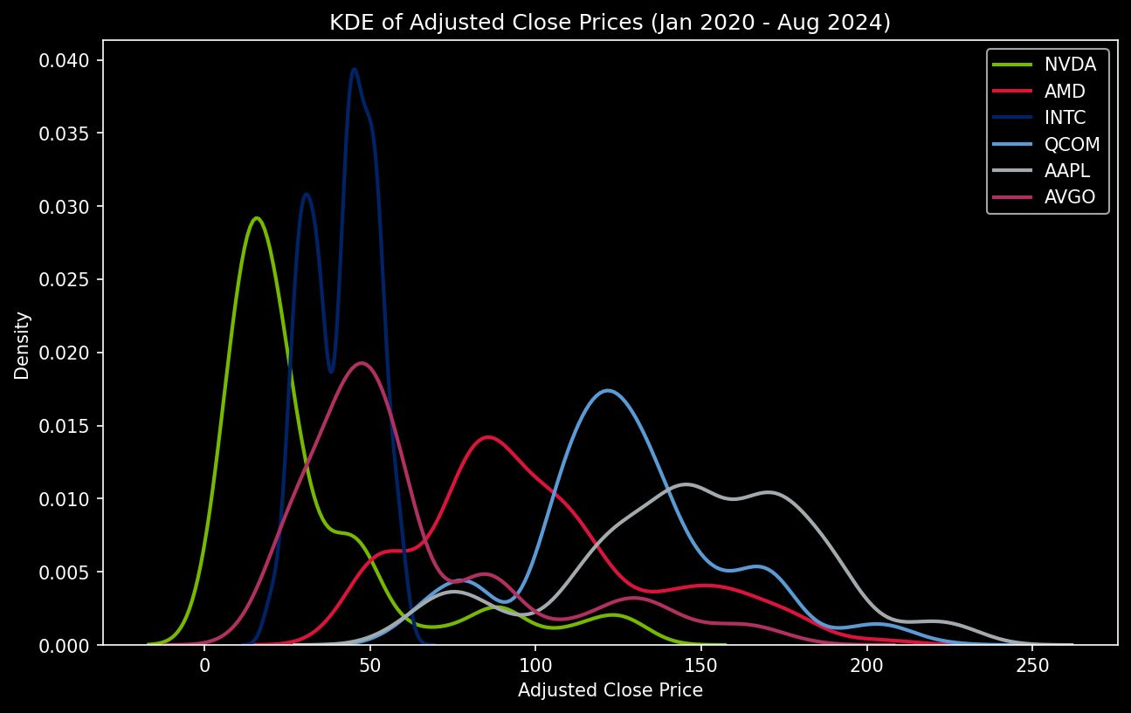
Stock Price Distribution Analysis (KDE)
Empirical Distributions of Adjusted Close Prices (Jan 2020-Aug 2024)

Slide 8
Statistical and Financial Modeling

Slide 9
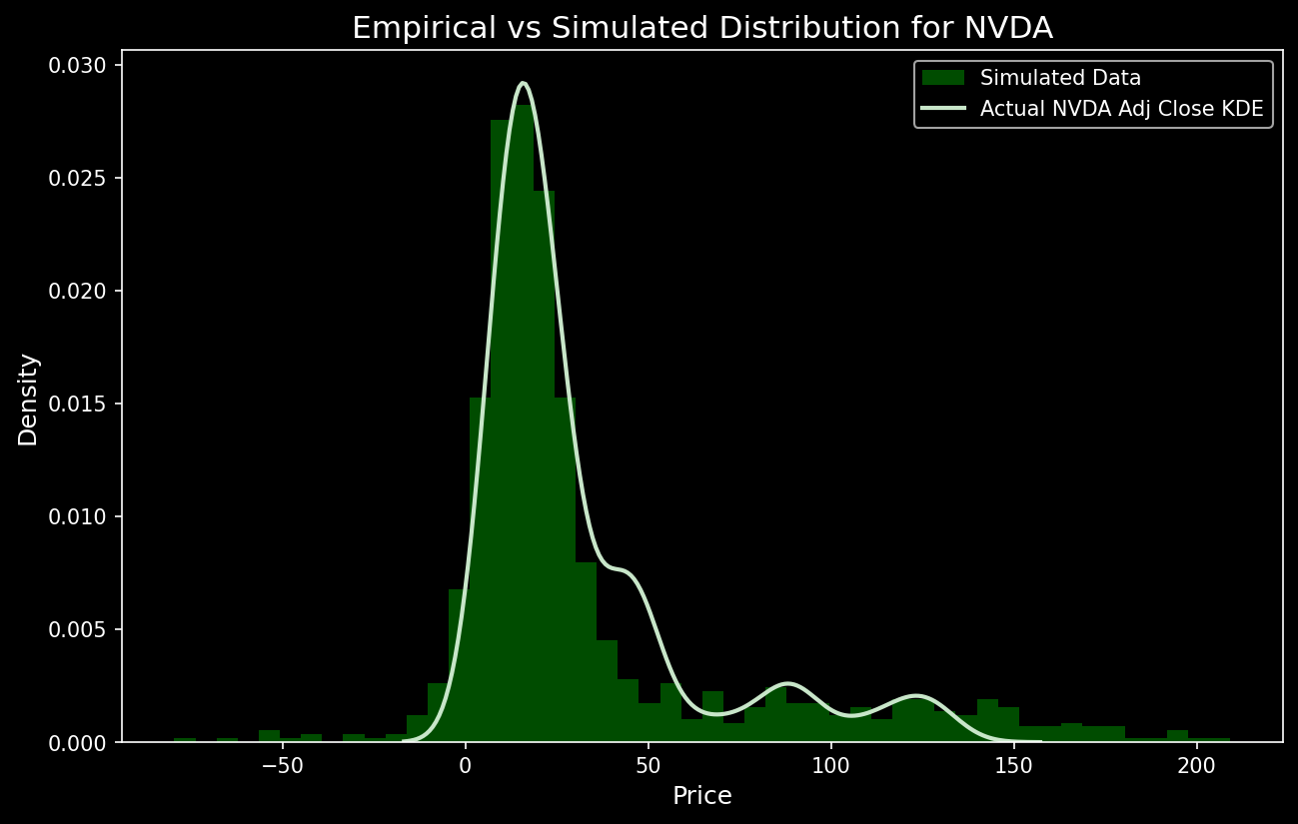
Mixture Modeling
Tuned Parameters: mu_1 = 16
sigma1 = 10
mu_2 = 80
sigma2 = 60
p = 0.7
T = 1000

Slide 10
Bootstrap Analysis
B = 1000
 | NVDA | AMD | INTE | QCOM | AAPL | AVGO
Mean Confidence Interval (95%) | (30.04 , 33.53) | (98.68 , 102.66) | (40.84 , 42.02) | (125.39 , 128.67) | (144.6 , 148.98) | (61.1 , 65.21)
Standard Error of Mean Confidence Interval (95%) | (0.81 , 0.92) | (0.99 , 1.07) | (0.28 , 0.3) | (0.85 , 0.93) | (1.05 , 1.13) | (1.01 , 1.11)
Std Confidence Interval (Method 1, 95%) | (27.7 , 31.48) | (33.77 , 36.55) | (9.6 , 10.15) | (29.13 , 31.97) | (35.96 , 38.88) | (34.52 , 37.89)
Std Confidence Interval (Method 2, 95%) | (27.7 , 31.48) | (33.77 , 36.55) | (9.6 , 10.15) | (29.13 , 31.97) | (35.96 , 38.88) | (34.52 , 37.89)
Notes:
1. Confidence Interval of Mean (μ_boot): 95% confidence interval of the mean fall in this range
2. Confidence Interval of Standard Error of Mean (se_boot):95% confidence interval of the standard error fall in this range
3. Confidence Interval of Stock Price Standard Deviation (std_boot):
x_boot_std represents the 95% confidence interval for the standard deviation (volatility) of the stock prices.
The standard deviation shows how much individual stock prices deviate from the mean (how volatile the stock is).
There are two methods used here:
Method 1: This uses the standard error of the mean to approximate the standard deviation.
Method 2: This calculates the actual bootstrap sample standard deviation.
For example:
NVIDIA: The confidence interval for standard deviation using both methods is [27.89, 31.47].
AMD: The confidence interval for standard deviation is [33.72, 36.61].
NVIDIA has a lower standard deviation compared to AMD, indicating that NVIDIA’s stock price is less volatile than AMD’s. Lower volatility can be an advantage as it suggests more predictable stock performance.
Comparative Analysis for NVIDIA's Advantage:
Lower Volatility (Standard Deviation): NVIDIA has a lower standard deviation compared to competitors like AMD and AAPL. This suggests that NVIDIA's stock price is more stable and less prone to extreme fluctuations, which is typically viewed as a sign of less risk in stock market investments.
Precision in Mean Estimation: NVIDIA's narrower confidence interval for the mean indicates that the stock's average price is estimated with greater precision, suggesting a lower risk of price uncertainty compared to AMD, QCOM, and others.
Competitor Comparison:
NVIDIA has a lower stock price compared to many competitors (like AMD and AAPL), but lower volatility might make it more attractive for conservative investors.
Although AMD's mean stock price is higher, its wider confidence intervals for the mean and higher standard deviation suggest that AMD’s stock is more volatile and unpredictable.
Summary of NVIDIA’s Highlights:
Lower volatility (standard deviation) than most competitors (except INTC), indicating more stable performance.
Precise mean stock price estimate with a narrow confidence interval, highlighting greater reliability and predictability.
Moderate standard error, reflecting consistent stock price behavior with smaller fluctuations in the mean.

Slide 11
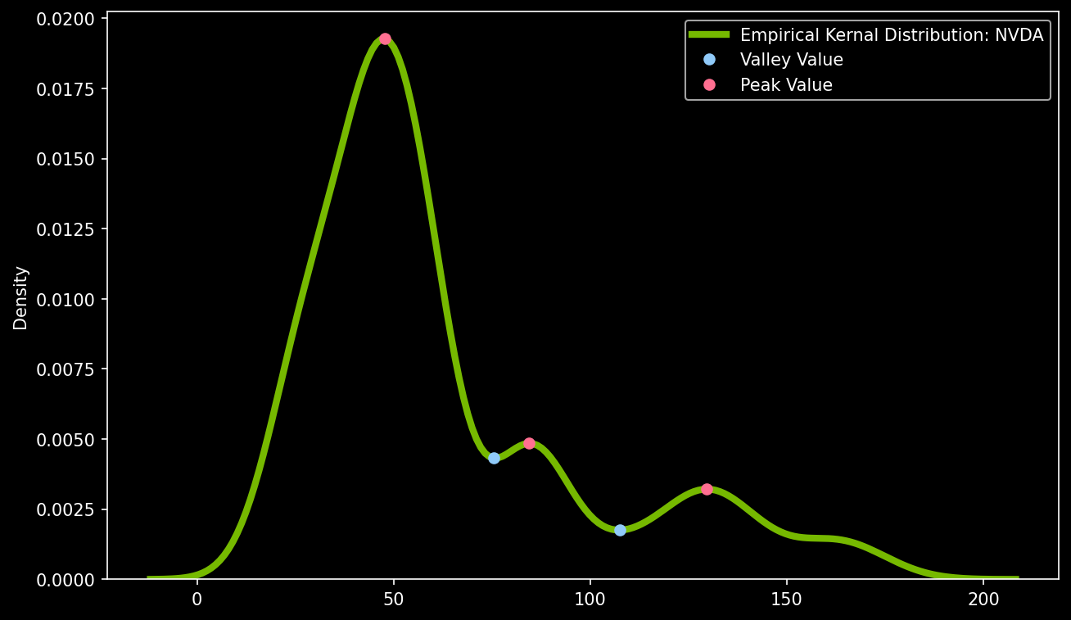
Monte-Carlo Simulation
Simulation Method
1. Set the Initial Values for Mu_1 and Mu_2

Slide 12
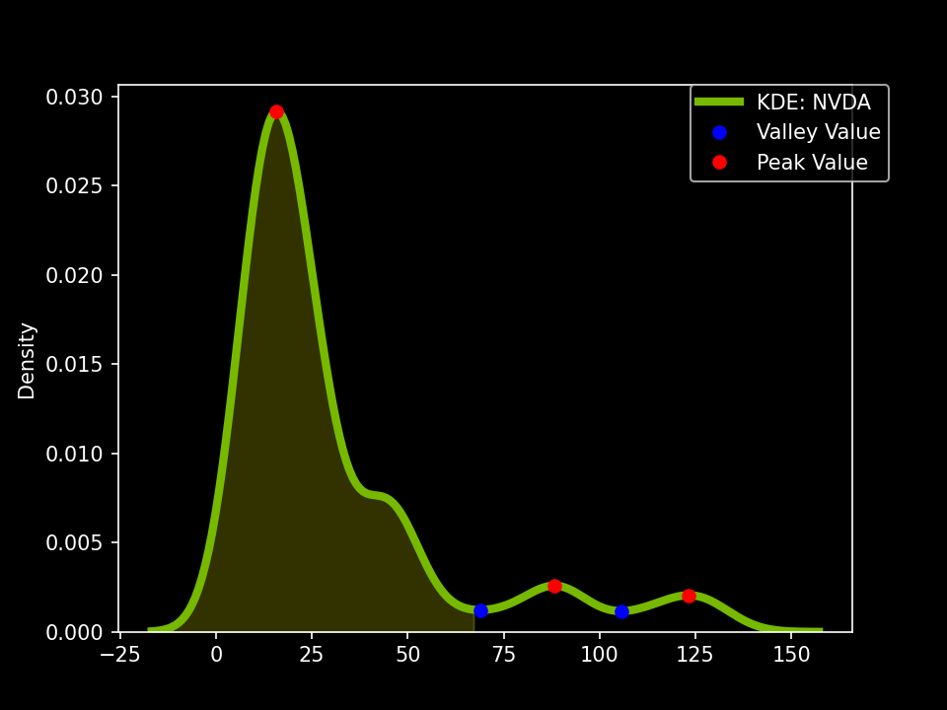
Monte-Carlo Simulation
Simulation Method
1. Set the Initial Values for Probability Value
Probability =
S(Area of Cutoff)/S(Total Area)

Slide 13
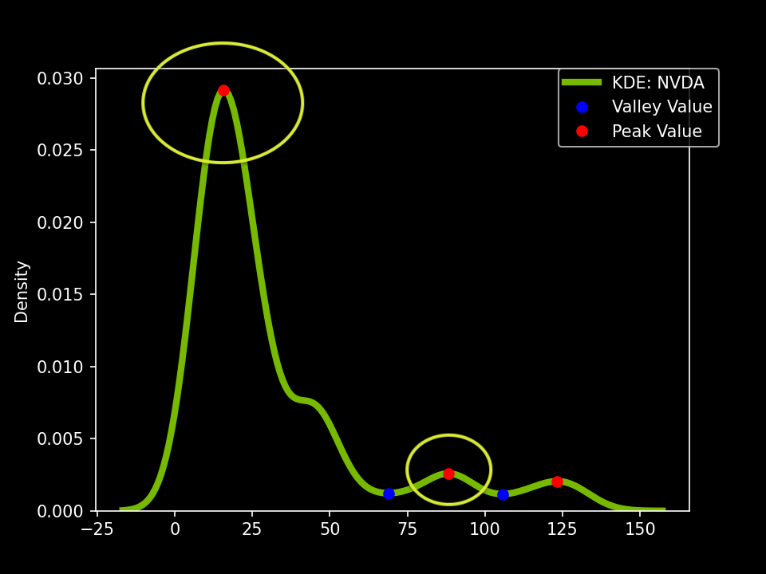
Monte-Carlo Simulation
Simulation Method
1. Set the Initial Values
for Sigma:
sigma1
sigma2

Slide 14
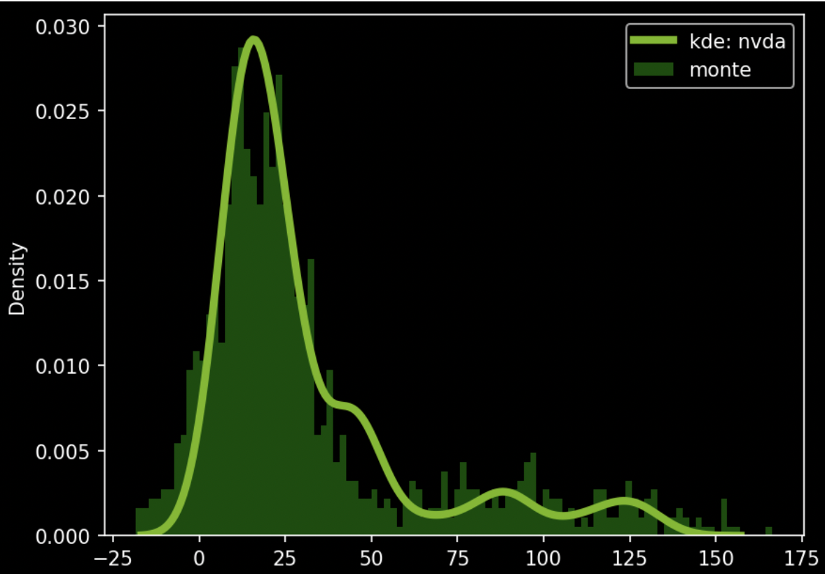
Monte-Carlo Simulation
Simulation Method
1. Set the Initial Values
for Sigma:
Input initial parameters
mu_1: 16
mu_2: 88
p: 0.8
sigma1 : 13
sigma2 : 35
Slightly adjust

Slide 15
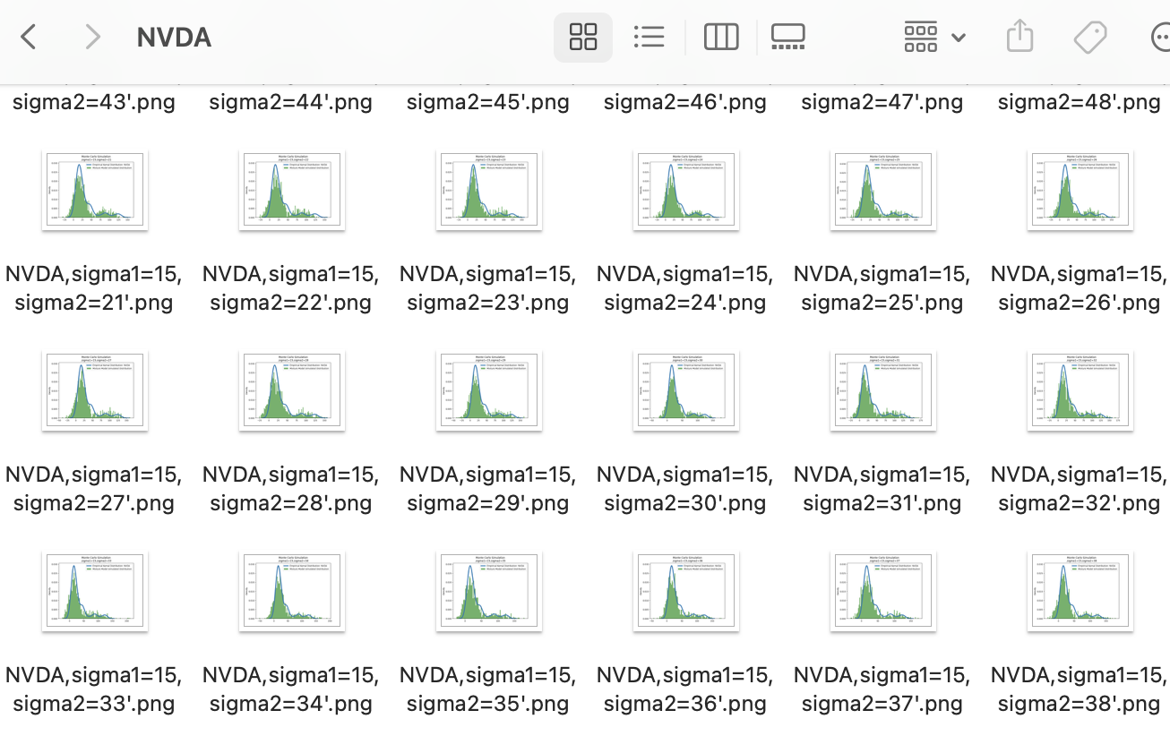
Monte-Carlo Simulation
Simulation Method
2. Find the best parameters:
Define the ratio range:
Set a ratio range:
sigma1 * ratio
sigma2 * ratio
Keep the qualifying images:
Calculate the overlap ratio
Keep image (ratio >= 0.5)
Manually select the image

Slide 16
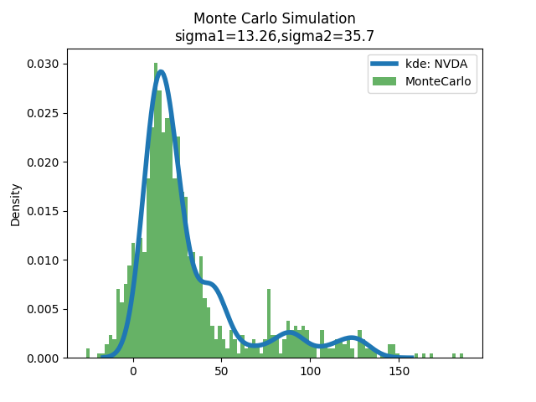
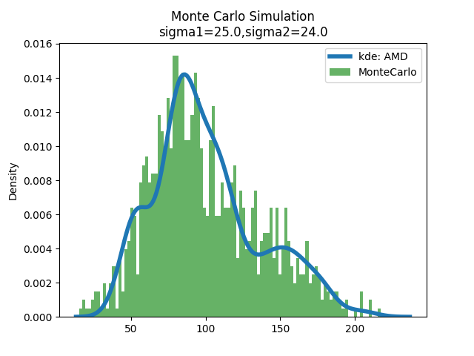
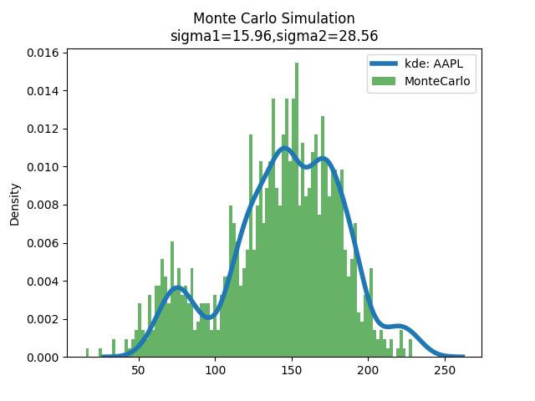
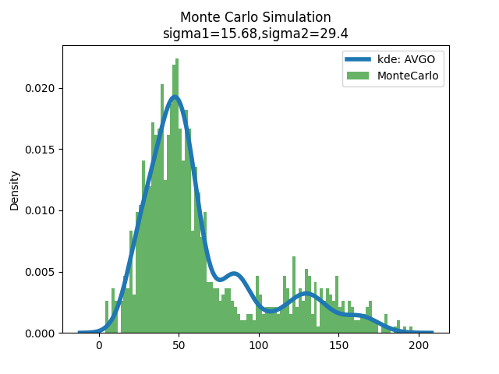
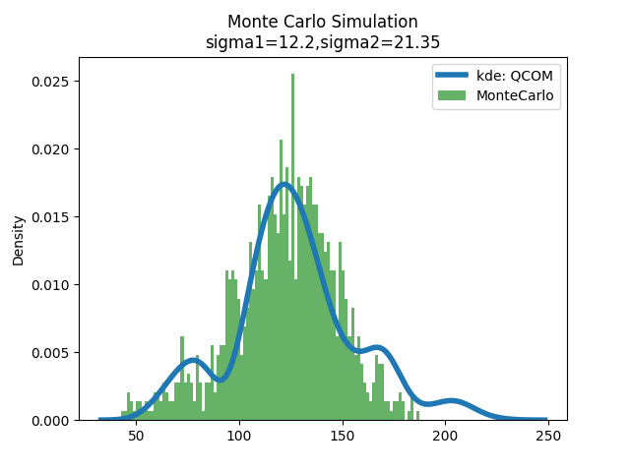
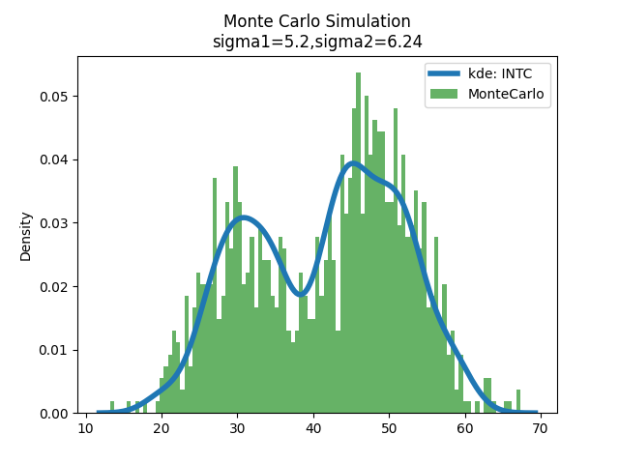
Monte-Carlo Simulation Result
NVDA
AMD
AAPL
AVGO
QCOM
INTC

Slide 17
Monte-Carlo Simulation
 | NVDA | AMD | INTN | QCOM | AAPL | AVGO
Mu_1 | 16 | 86.20013076 | 30 | 70 | 70 | 45
Mu_2 | 88 | 151.50455195 | 48 | 126 | 154 | 128
Sigma1 | 13.26 | 25 | 5.2 | 12.2 | 15.96 | 15.68
Sigma2 | 35.7 | 24 | 6.24 | 21.35 | 28.56 | 29.4
Probablity | 0.8 | 0.820005 | 0.36 | 0.08 | 0.15 | 0.75

Slide 18
Summary
Higher Demand from the AI Market
History Stock Price
Compare to Other Companies
Modeling

